Slide 1
Double Side Band Suppressed Carrier
(DSB-SC)
Signals and Communication Systems (24EC2105)

Slide 2
DSB-SC Generation and detection

Slide 3
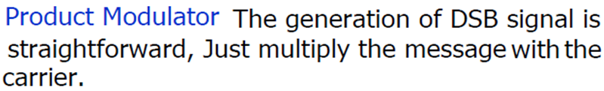
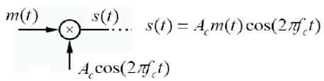
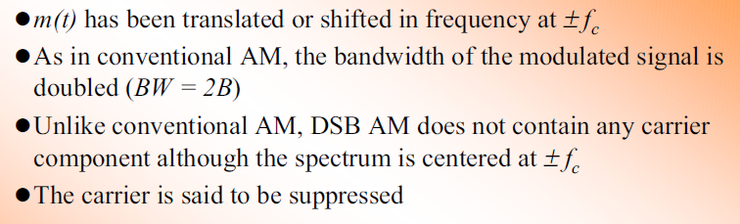
1. Multiplier Modulator

Slide 4
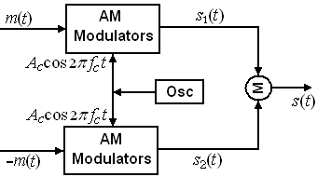
Balanced Modulator
+
-

Slide 5
DSB-SC Demodulation

Slide 6
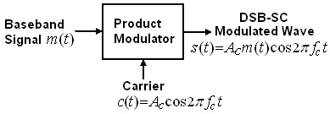
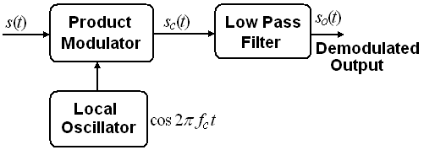
DSB-SC Modulation
Demodulation

Slide 7
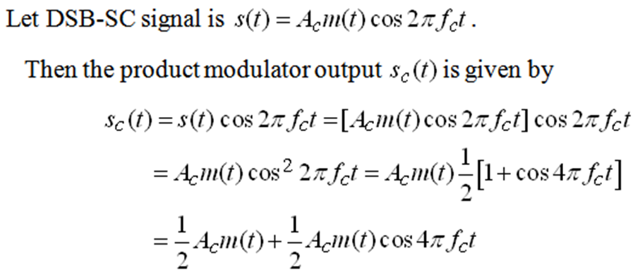
Coherent/Synchronous Detection
The Local oscillator frequency and phase is assumed to be synchronized with transmitted carrier

Slide 8
Any discrepancy in the frequency and phase of local carrier give rise to a distortion in the detector output.
Consider the following two situations.
The local oscillator has an ideal frequency, but arbitrary phase difference measured with respect to the carrier is referred to as ‘Phase Error’.
The local oscillator has identical phase but a difference frequency with respect to carrier is referred to as ‘Frequency error’.

Slide 9
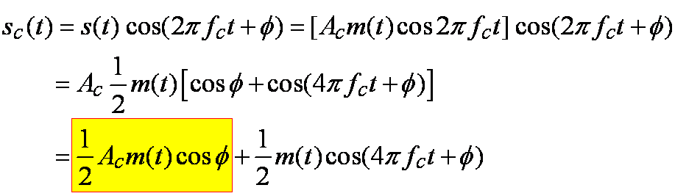
Phase Error
Let the carrier is where being the phase difference between the local oscillator signal and the carrier at the transmitter.
After LPF

Slide 10
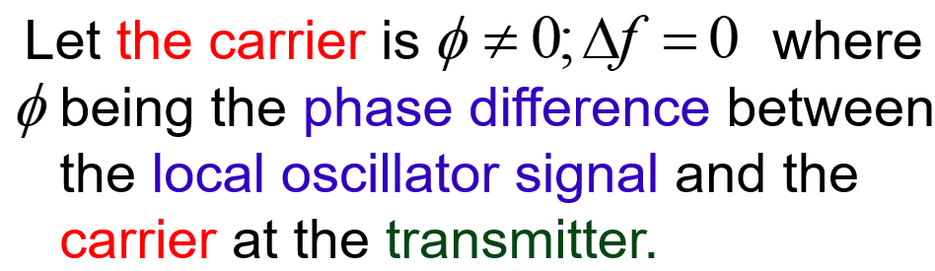
Phase Error
After LPF

Slide 11
Phase Error
Thus the demodulator output is proportional to and undistorted when the phase error is constant.
The demodulated output is maximum when
Minimum (zero) when . This results in distortion of the demodulated output .
Necessary arrangement should be made at the receiver end to maintain the local oscillator in perfect synchronism, in both frequency and phase with the transmitted carrier wave.

Slide 12
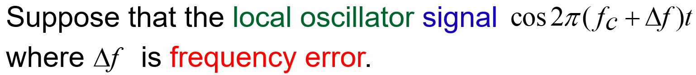
Frequency Error
After LPF

Slide 13
Conclusions
Necessary arrangement should be made at the receiver end to maintain the local oscillator in perfect synchronism, in both frequency and phase with the transmitted carrier wave.

Slide 14
Main Points of DSB-SC
The Carrier power is eliminated, so that efficiency increased in compare with standard AM.
But the Transmission Bandwidth is same as standard AM, that is two times of message signal bandwidth.
The phase of DSB-SC modulated signal is phase reversed when the modulating signal m(t) crosses zero .
Coherent detection is needed for DSB-SC: Obtaining the carrier phase is biggest challenges in all demodulators.

Slide 15
End

